Slide 1
PROFESSIONAL ETHICS CE 3142 ENGINEERS AND THE ENVIRONMENT
THE SIR JOHN KOTHELAWELA DEFENCE UNIVERSITY
22nd MARCH 2024

Slide 2
topics
Introduction
Institution of Engineers sri lanka, code of ethics : clause 3 – environment
Rule 3.1 – environmental impact assessment
Rule 3.2 – environmental laws
Rule 3.3 – co-operation
Rule 3.4 – new technologies
Rule 3.5 – minimize / re-use of waste
Rule 3.6 – conservation
Industry attitudes to environmental protection
acknowledgements

Slide 3
ENGINEERS AND THE ENVIRONMENT
introduction
Engineers have a complex relationship to the environment.
On the one hand, they have helped to produce some of the environmental problems that plague human society. Projects designed by engineers produce toxic chemicals that pollute the land, air, and rivers. Engineers also design projects that flood farmlands, drain wetlands, and destroy the forests.
On the other hand, engineers can design projects, products, and processes that reduce or eliminate these same threats to environmental integrity. If engineers have contributed to our environmental problems (as have most of us), then they are also an essential part of their solution.

Slide 4
Institution of Engineers sri lanka code of ethics clause 3 - environment
Engineers shall be committed to the need for sustainable management of the planet’s resources and seek to minimize adverse environmental impacts of their engineering works or applications of technology so as to protect both present and future generations .

Slide 5
Institution of Engineers sri lanka code of ethics clause 3 - environment
By using the expression ‘‘engineers shall,’’ the code requires engineers to “strive to comply with the principles of sustainable development,’’
to inform their clients or employers of the possible consequences of ignoring the principles of sustainable development,
to present information regarding the failure to comply with the principles of sustainable development to the proper authority in writing, and
to ‘‘cooperate with the proper authority in furnishing such further information or assistance as may be required”

Slide 6
iesl code of ethics clause 3 - environment
rule 3.1
shall carefully evaluate adverse environmental impacts and incorporate practical remedial measures to minimize them. {ENVIRONMENTAL impact assessment}
Environmental Impact Assessment (EIA) is a process of evaluating the likely environmental impacts of a proposed project or development, taking into account inter-related socio-economic, cultural and human-health impacts, both beneficial and adverse.
The EIA is a simple and straightforward process of first predicting the potential impacts of development activities on the natural and social environment, and then suggesting measures to prevent or minimize negative impacts and to enhance positive impacts

Slide 7
iesl code of ethics clause 3 - environment
How to Carry Out an Environmental Impact Assessment
Determine the scope of the environmental impact assessment (EIA) through a process of screening. EIA is mandatory for certain projects.
Identify the key issues to be examined in more detail (scoping) during the assessment including the:
impacts to be assessed
alternatives to be examined.
Provide an Environmental Statement on the EIA describing the proposed development. Include information on:
overall purpose and specific aims of the development
physical characteristics of the development
production processes that will be involved
levels of waste and emissions likely to arise from the development.

Slide 8
iesl code of ethics clause 3 - environment
How to Carry Out an Environmental Impact Assessment
Consider the alternatives to the proposed development that may be more environmentally acceptable.
Study the state of the potentially affected environment in the absence of the project to provide a baseline against which the possible effects of the project can be measured.
Predict the likely significant environmental effects of a proposed development. Focus on aspects such as air quality, visual and landscape aspects, ecological impacts, hydrogeology, transport, economic impacts, etc.
Make a distinction between the magnitude and significance of likely impacts.
Describe the measures designed to avoid, reduce and if possible, remedy significant environmental effects in the Environmental Statement.
Clearly document in a published, publicly available report, the Environmental Statement.

Slide 9
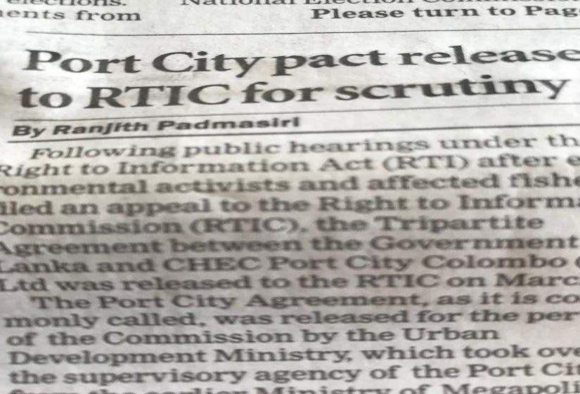
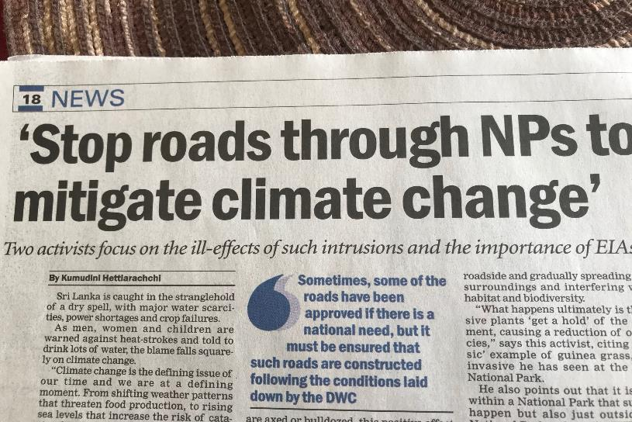
Protest against roads being constructed through the Wilpattu Sanctuary, which is causing damage to the ecological balance and the environment. No EIA has been done for this project
Tripartite agreement for Port City project finally released to RTI Commission for examination, because of protest by environmental and civil rights groups that the original EIA did not address coast conservation and loss of livelihood issues
The Sunday Times – March 8, 2020

Slide 10
iesl code of ethics clause 3 - environment
rule 3.2
shall consider theoretical, legislative, regulatory and policy aspects of environmental protection and sustainable management of the available resources. {Environmental laws}
the National Environmental Act, Act No. 47 of 1980.
AN ACT TO ESTABLISH A CENTRAL ENVIRONMENTAL AUTHORITY TO MAKE PROVISION WITH RESPECT TO THE POWERS, FUNCTIONS AND DUTIES OF THAT AUTHORITY ; AND TO MAKE PROVISION FOR THE PROTECTION AND MANAGEMENT OF THE ENVIRONMENT AND FOR MATTERS CONNECTED THEREWITH OR INCIDENTAL THERETO.

Slide 11
iesl code of ethics clause 3 - environment
Regulations :
1. order published under the Gazette Notification No. 1533/16 dated 25.01.2008
(Re: Environmental Protection License Prescribed Activities)
the activities set out in the Schedule hereto as activities for which a License is required under the aforesaid section being activities which involves or results in discharging, depositing or emitting waste into the environment causing pollution.
This includes around 140 industries, such as Healthcare services, Vehicle service stations, Food manufacturing and processing industries, Paper and pulp industries, etc.
2. Environmental Protection & QUALITY
3. AIR QUALITY
4. NOISE
5. AMBIENT WATER QUALITY
6. WASTE MANAGEMENT

Slide 12
iesl code of ethics clause 3 - environment
rule 3.3
Shall work in close co-operation with members of other professions and disciplines on achieving sustainable development {CO-OPERATION}
Large infrastructure development projects such as power generation and distribution, irrigation, highway construction, etc. though basically engineering in concept, involve the expertise of many other disciplines
While the core Engineering team is there to address technical issues for the preparation of the EIA, the inputs of other professionals such as Environmentalist, Sociologist, Geologist, Economist, Gender Specialist, Agriculturist, etc. are also required.
Hence the Engineers have to work in close co-operation with the other Professional, if the EIA is to address all major project activities that could have an adverse effect on the project area, both environmentally and socially

Slide 13
iesl code of ethics clause 3 - environment
rule 3.4
shall critically analyze how the proposed project or the application of technology relates to sustainability considerations. {ENVIRONMENTAL PROTECTION}
When new technologies are to be introduced, it is very important that the engineers involved in the initial designs ensure that the processes involved do not adversely impact on the environment and health and safety of the public

Slide 14
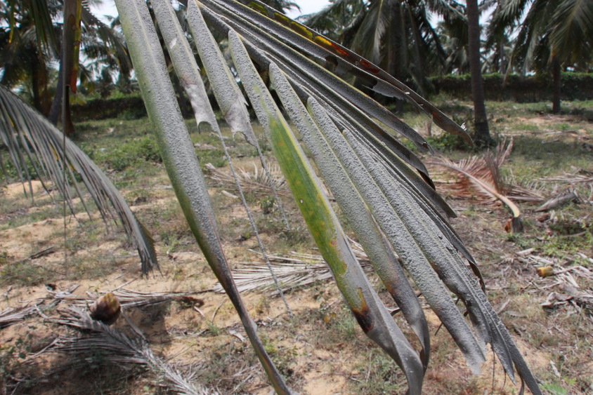
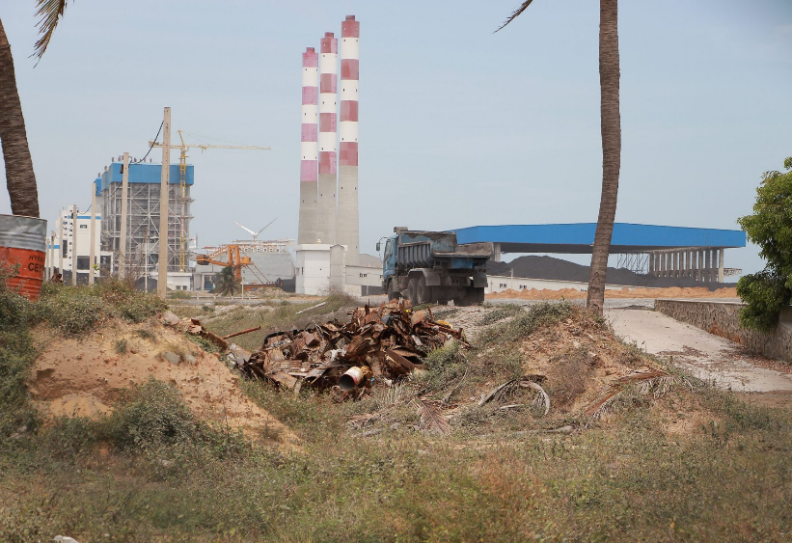
Norochcholai Coal Power Plant
The Lakvijaya Coal Power Plant, more commonly known as the Norochcholai Coal Power Plant (NCPP) is located in the village of Narakkalli and Penaiyadi near Norochcholai, within Puttalam District, on the West Coast of the Kalpitiya Peninsula. The power plant was proposed by the Ceylon Electricity Board (CEB) in 1995 and the construction of the facility began in 2007. It was constructed in 3 phases and completed by September 2014, with a total power generation of 900 MW.

Slide 15
Norochcholai Coal Power Plant
Types of Pollution As A Result of Coal Power Generation
Solid Waste
a coal power plant releases tonnes of ash every day as sludge. If there is no provision for safe storage and disposal, wind-borne the particles from this sludge can lead to respiratory diseases among nearby residents. Also Harmful chemicals such as Arsenic, Chromium, Mercury and Cadmium may be present in the sludge, leading to the spread of diseases.
Cooling Water Discharge
Thousands of gallons of water are used in the cooling systems of coal power plants. This water is generally four to five degrees Celsius hotter than normal. Whenever this water is released into any water source, the marine life in that area will be threatened.
Waste heat
A considerable percentage of heat produced by thermal power plants is wasted. Above all, gas emissions of Sulphur Dioxide and Carbon Dioxide can lead to global warming and acid rain. In Sri Lanka

Slide 16
iesl code of ethics clause 3 - environment
Extension of Norochcholai coal power plant - Putting people from THE frying pan into the fire
The Cabinet of Ministers at its meeting held on 24.09.2019 has granted approval to build a fourth unit of 300 MW coal power plant (CPP) at the premises of the existing 900 MW CPP at Norochcholai.
President focuses on Norochcholai coal power plant problems
Instructs officials to implement project according to proper technical procedures and environmental requirements
Suggests permanent solutions for issues affecting people’s day-to-day lives
Steps taken to meet 80% of energy requirement through renewable energy by 2030

Slide 17
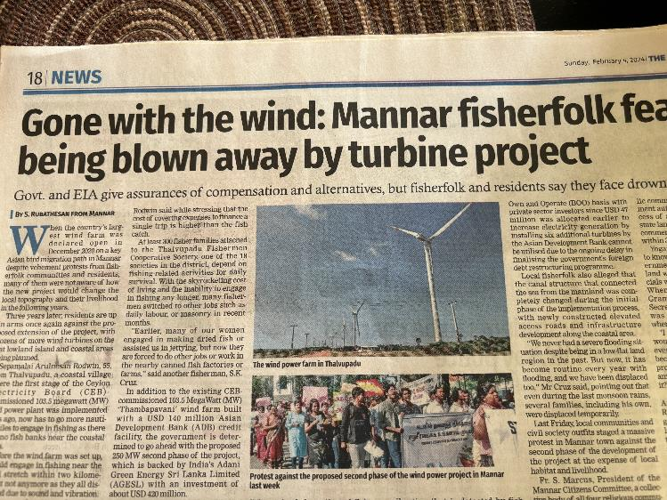
iesl code of ethics clause 3 - environment
MANNAR WIND POWER FARM
PHASE 1 – 103.5 MW 30 turbines [ADB FUNDED]
PHASE 2 – 250 MW 52 turbines [ADANI]
Severe affects on the livelihood of the fishing community
Will kill more birds as it within the flight path of migratory birds
The EIA for Phase 2 (600+ pages) does not appear to take serious note of these two major sociological & Environmental issues
Sunday Times : February 4, 2024

Slide 18
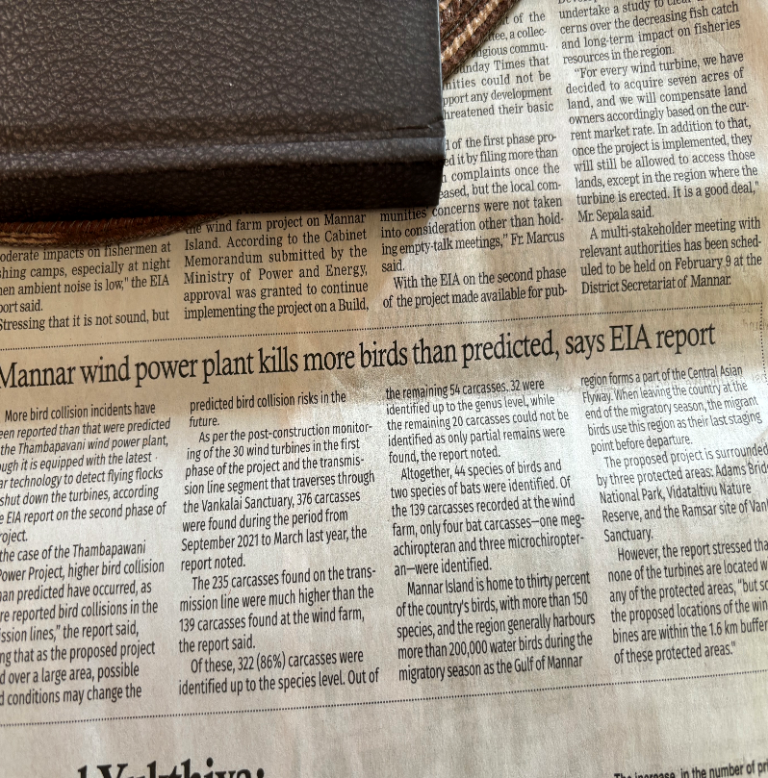
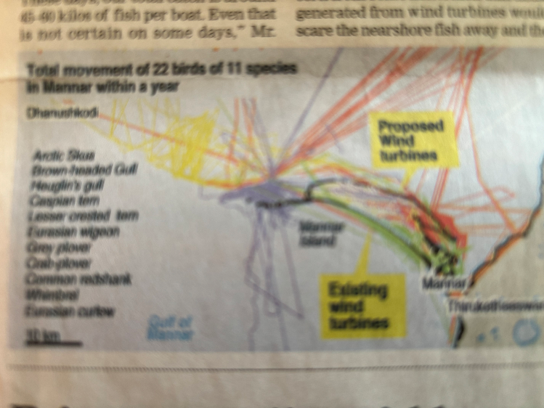
iesl code of ethics clause 3 - environment

Slide 19


iesl code of ethics clause 3 - environment
+++++++ ve
What is 5G exactly?
It's the next generation of mobile internet connection and offers much faster data download and upload speeds.
Through greater use of the radio spectrum it will allow far more devices to access the mobile internet at the same time. faster speeds and more reliable connections on smartphones and other devices than ever before.
- - - - - - - ve
We Have No Reason to Believe 5G Is Safe
The rollout of 5G using super high-frequency radio airwaves has ignited old fears about cellphone radiation risks.
Dozens of independent studies indicates that 5G is a risk to all biological life
Brussels Becomes First Major City to Halt 5G Due to Health Effects

Slide 20
iesl code of ethics clause 3 - environment
rule 3.5
shall identify and assess options for material recovery and disposal. {MINIMIZE/ REUSE OF WASTE & SAFE DISPOSAL}
1. Construction and Demolition (C&D) Waste
In most countries with ongoing infrastructure development projects, a large quantity of C&D wastes is produced representing a large fraction of the total solid waste stream. The disposal of these wastes has become a severe social and environmental problem, mainly because of the absence of reclamation sites and landfill space

Slide 21
iesl code of ethics clause 3 - environment
Construction and Demolition (C&D) Waste (contd)
There are two main kinds of building construction waste: waste generated by superstructure construction (structure waste) and waste generated by work related to finishing (finishing waste).
Concrete fragments, reinforcement bars, steel off-cuts, unused or discarded timber sections and pieces are structure waste.
The sources of finishing waste range widely from surplus cement mortar arising from screeding works over the building floors, broken raw materials such as mosaic tiles, ceramics, stone fragments, plastering materials and empty paint tins. The packaging materials of household appliances, such as gas cookers, bathtubs, washtubs and window frames, are also part of finishing wastes

Slide 22
iesl code of ethics clause 3 - environment
Construction and Demolition (C&D) Waste (contd)
As Engineers working at construction sites have to take action to reduce, reuse, sort and recycle construction waste before disposal.
Most of the inert wastes from excavation that are sorted on the spot are re-used as backfilling materials. Any surplus which is taken to other sites as filling material or is dumped as filling material in reclamation work. Demolished concrete from excavation work and building demolitions is collected and crushed as recycled aggregates for road sub-bases, paving blocks and recycled aggregate fresh concrete.

Slide 23
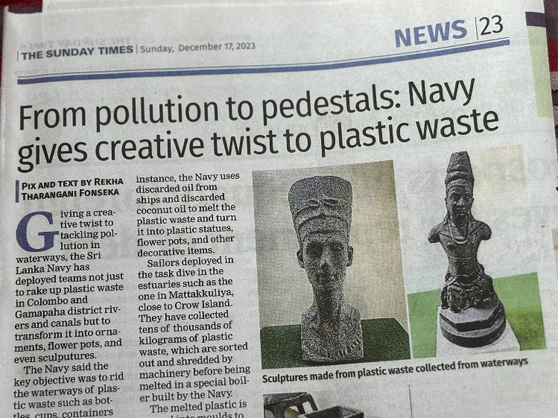
iesl code of ethics clause 3 - environment
A highly commendable project by the sri lanka navy
Collect plastic waste from waterways
Sort and shred the plastic
Melt in hot oil (waste from ships or discarded coconut oil)
Pour into moulds to make statues, flower pots, etc.
Cleaning the pollution caused by people
Recycling scrap into something useful
Sunday Times : December 17, 2023

Slide 24
iesl code of ethics clause 3 - environment
rule 3.6
shall analyze opportunities for resource and energy conservation and, design appropriately optimized systems. {CONSERVATION}
Resource conservation is management of the use of natural resources to provide the maximum benefit to current generation while maintaining capacity to meet the needs of future generations.
Conservation includes both the protection and rational use of natural resources.
The four natural resources are :
renewable,
living,
non renewable, and
fossil fuels.

Slide 25
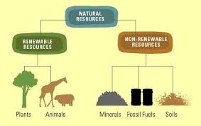
iesl code of ethics clause 3 - environment
Resource conservation
Renewable - Renewable resources is something that can be renewed e.g. a tree
Living - Living resources are important to mankind because they provide food
non renewable - Non renewable resources such as metals are important because they are needed for industry
fossil fuels - Fossil fuels such as oil, coal and diesel are very important because they provide the power required by industry and also for domestic use

Slide 26
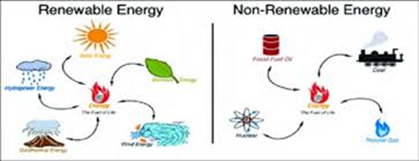
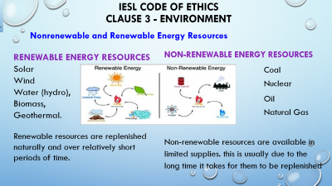

iesl code of ethics clause 3 - environment
Nonrenewable and Renewable Energy Resources
RENEWABLE ENERGY RESOURCES
Solar
Wind
Water (hydro),
Biomass,
Geothermal.
Renewable resources are replenished naturally and over relatively short periods of time.
Non-renewable energy resources
Coal
Nuclear
Oil
Natural Gas
Non-renewable resources are available in limited supplies. this is usually due to the long time it takes for them to be replenished

Slide 27
Thalangama wetland conservations ?????
Since 2007 the wetland and its surroundings are gazetted as an environmental protection area [epa] under the national environmental act [nea] owing to its “ecological, hydrological and historical importance”
There will be 17.3 km elevated 4-lane highway linking the new Kelaniya bridge to the outer circular highway at pore, athurugiriya.
3 km of this will cross part of the thalangama wetland, disturbing this ecologically sensitive area.
The cea has sought the Attorney general’s advise on revising the gazette, but AG has said this would be a violation of the nea

Slide 28
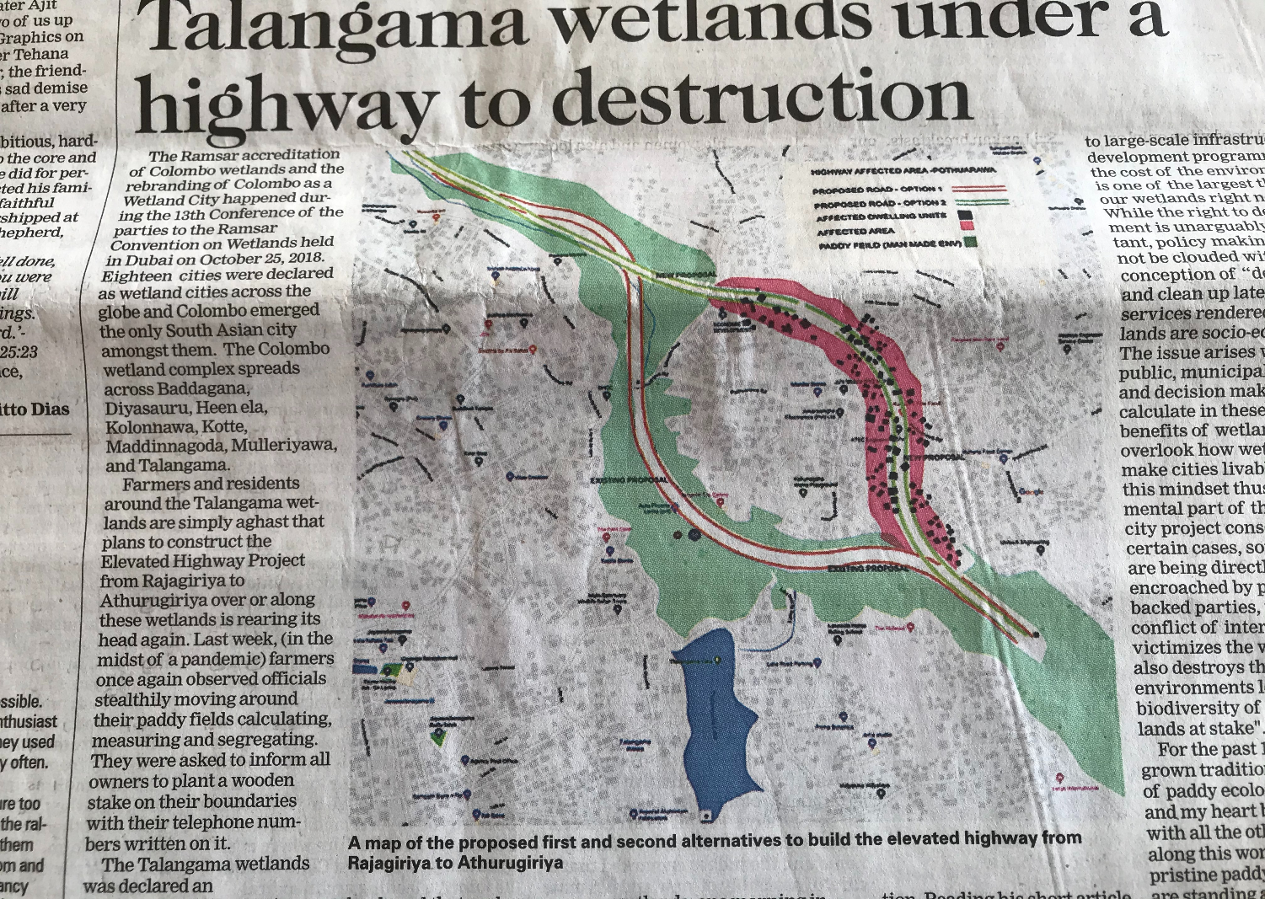

Slide 29
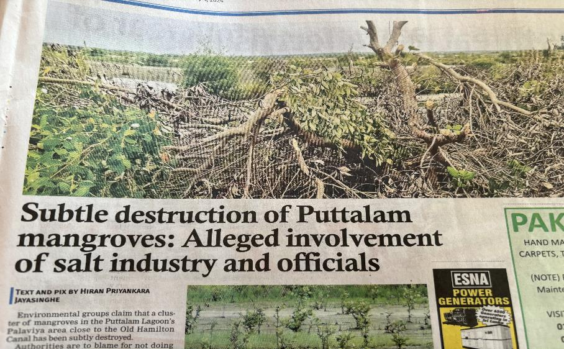
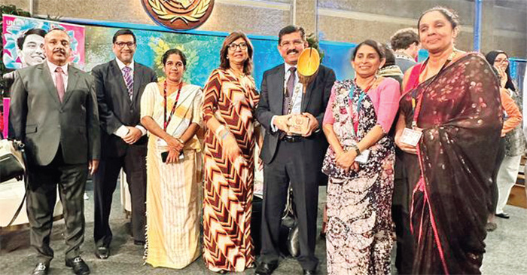
Mangrove conservation
Sri Lanka receives esteemed UN Award for Mangrove Ecosystem Restoration Excellence
At the 6th Assembly of the United Nations Environment (UNEA), Sri Lanka was honoured with the prestigious World Restoration Flagship Award by the United Nations Environment Programme (UNEP) for its remarkable efforts in accelerating the natural revival of mangroves, crucial for ensuring the well-being of communities across the island nation.
Sunday Times : 04/02/2024
????
The Island (E-Paper) 29/02/2024

Slide 30
Veddha chief files writ petition against Mahaweli Authority
Leader of Sri Lanka’s indigenous Vedda community, Wannila Aththo filed a writ petition in the Court of Appeal against the massive environmental destruction taking place at the Galwalayaya forest reservation adjacent to Pollebedda-Maha Oya in the Ampara District.
The Vedda chief alleged that hundreds of acres of forest land were destructed by foreign companies, using dozers and heavy machinery.
He alleged that they had now lost their right to livelihood in their ancestral lands.
Nearly 6,000 acres belonging to the forest reservation had been divided into 15 parts and sold among 15 private companies to grow maize , by the Mahaweli Authority.
It was said that this environmental destruction within the reservation will directly impact the catchment areas of the Rambakan Oya Reservoir.

Slide 31
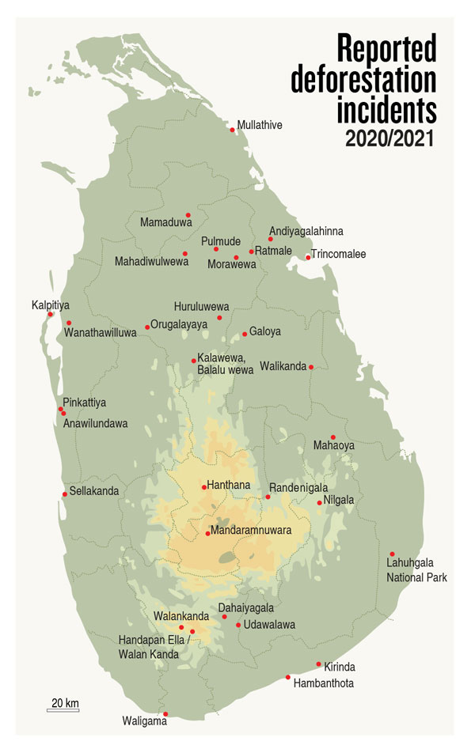
The Sri Lankan cabinet’s recently announced plan to revoke Circular No. 5/2001, which protests the country’s Other State Forests (OSFs), and transfer jurisdiction for these protected areas from the Forest Department to the authorities at the divisional and district levels.
The circular safeguards around 500,000 hectares of OSFs that are not otherwise protected. As these forests are used by animals, especially elephants, as migratory corridors, their segregation into agricultural lands might lead to increased elephant-human conflict, thus again adversely affecting the economy and livelihoods of communities living in the area. .
The forest cover of Sri Lanka in 2019 was reported to be 16.5 percent, down from 29.7 percent in 2017.
In 1882, the country’s forest density was around 82 percent. Between 1990 and 2000, Sri Lanka lost an average of 26,800 hectares of forest per year, which amounts to an average annual deforestation rate of 1.14 percent. In total, between 1990 and 2005 alone, Sri Lanka lost 17.7 percent of its forest cover.

Slide 32
Industry attitudes towards the environment
The first attitude is the SUB-MINIMAL ATTITUDE.
Industries in this group do as little as is possible—and sometimes less than is required—in meeting environmental regulations. They often have no full-time personnel assigned to environmental concerns, devote as few financial resources as possible to environmental matters, and fight environmental regulations.
If it is cheaper to pay the fines than make the mandated changes, this is what they will do.
Industries in this group generally hold that the primary goal of the company is to make money, and environmental regulations are merely an impediment to this goal.

Slide 33
Industry attitudes towards the environment
The second attitude is the MINIMALIST OR COMPLIANCE ATTITUDE.
Firms adopting this orientation accept governmental regulation as a cost of doing business but often without enthusiasm or commitment. They are skeptical about the value of environmental regulation. Nevertheless, these firms usually have established company policies that regulate environmental matters and have established separate units devoted to them.
A third attitude is the PROGRESSIVE ATTITUDE.
In these companies, being responsive to environmental concerns has the complete support of the CEO. The companies have well-staffed environmental divisions, use state-of-the-art equipment, and generally have good relationships with governmental regulators. They are genuinely committed to environmental protection

Slide 34
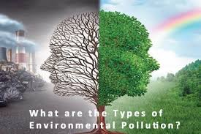
,

Slide 35
acknowledgement
http://www.cea.lk/web/index.php/en/environmental-impact-assessment-eia-procedure-in-sri-lanka
https://app.croneri.co.uk/topics/environmental-impact-assessment-environmental-aspects-and-impacts/how-carry-out-environmental
http://www.cea.lk/web/en/acts-regulations
https://efl.lk/portfolio/norochcholai-coal-power-plant/
https://groundviews.org/2017/10/12/the-dark-side-of-norochcholai/
https://www.cnet.com/news/5g-phones-and-your-health-what-you-need-to-know/
https://blogs.scientificamerican.com/observations/we-have-no-reason-to-believe-5g-is-safe/
https://htodd5.wixsite.com/hannahsweb/single-post/2015/10/29/The-FOUR-TYPES-OF-NATURAL-RESOURCES
https://www.kqed.org/quest/64341/nonrenewable-and-renewable-energy-resources-2
https://www.quora.com/What-are-the-main-types-of-environmental-pollution
The Sunday Times : 08/03/2020, 31/01/2021, 17/12/2023 & 04/02/2024: Wijaya Newspapers Ltd, Colombo 2
The island (e-paper): 29/02/2024
https://thediplomat.com/2020/10/fighting-deforestation-in-sri-lanka/

Slide 36
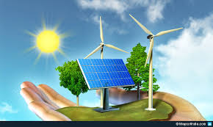
THANK YOU !!!

